Slide 1
Reactions 10
J. Fission

Slide 2
































Slide 3

























Slide 4































Slide 5




























Slide 6



























Slide 7














Slide 8





























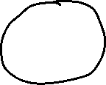




















Slide 9


































Slide 10























































Slide 11



























Slide 12

















Slide 13




































Slide 14




































Slide 15

















Slide 18





































Slide 19
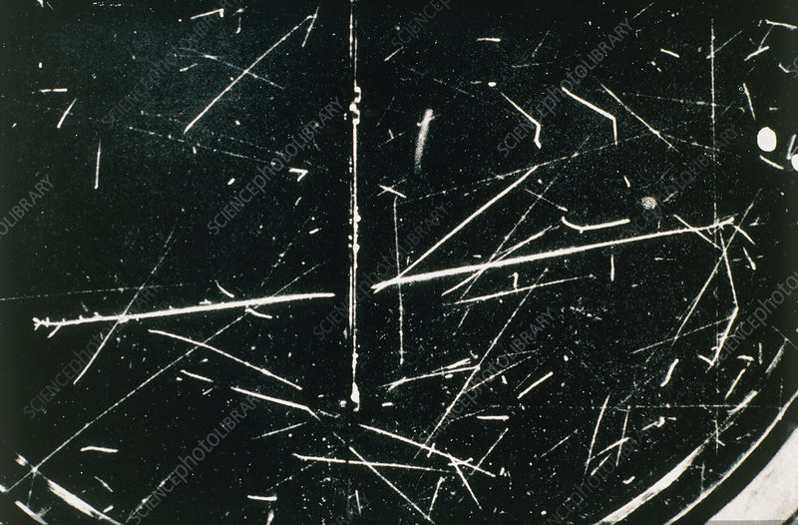

Single fission of U nucleus
Fragments

Slide 20























Slide 21

















































Slide 22










